Slide 1

Introduction to Supply Chain Management and Demand Forecasting
Madhwesh Parthakudi

Slide 2


About Me
Business Architect (2020-Present)
Digital Transformation for Supply Chain Planning, Cisco
Supply Chain Planner (2013 – 2020)
Distribution Inventory Management and Demand planning, Cisco
Operations Associate (2011-2013)
Logistics, Procurement and Supplier Management, Sainsbury’s
Masters (2010-2011)
Operations and Supply Chain Management, Manchester Business School
Madhwesh Parthakudi
Business Architect, Cisco
IT Consultant (2008-2010)
Test consultant for the Utilities sector, SAP Labs

Slide 3

Global Supply Chain Management
Business Impact of Forecasting
Characteristics of Forecasts

Slide 4
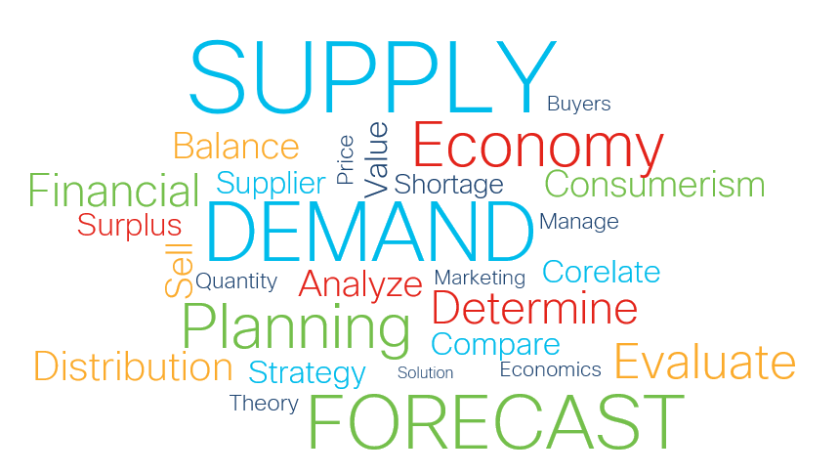
Demand/Supply Planning
Inventory Management
Logistics Management
Supply Chain Network Design
Supply Chain Risk Management
Notes:
What is SCM
“the integration of key business processes from end-users to suppliers that provide products and services to maximize customer value and achieve sustainable competitive advantage”
Adjusting inventory/logistic levers

Slide 5
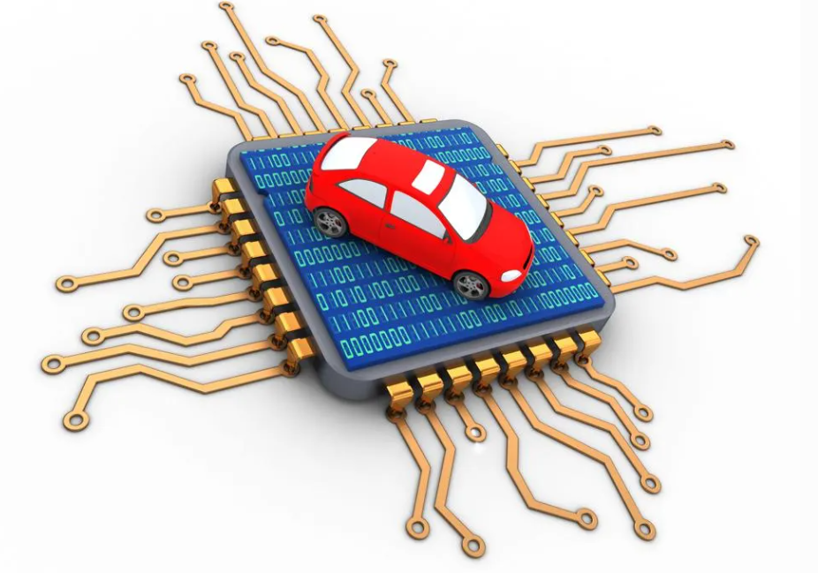



Global Supply Chain Management
All about balancing Demand and Supply
Supply
E.g.,
Semiconductor Shortage 2021-22
D > S
Stock outs/Lost Revenue
Customer dissatisfaction
>
Demand
Demand
D < S
High Inventory Costs
Obsolescence
<
E.g.,
Office Real Estate Sector 2020-22
Supply
Demand
=
Supply
E.g.,
Education sector
2020-22
D = S
High Customer Service
Low Inventory Costs
Notes:
Top line Revenue and Bottom line savings

Slide 6
Business Impact of Forecasting
Forecasts are needed to execute Business Plans (both for companies manufacturing products or offering services).
Forecast requirements and formats vary by each Function (Production, Marketing, Sales, or Finance) in a company.
While forecasting acts as a vital input for business decisions, they are not decision themselves.
Lack of Good Forecasting
(Demand and Supply Imbalance)
High Inventory Cost & Obsolescence
Frequent Stock-outs
(Lost Sales)
Low Levels of Customer Service

Slide 7
Quiz
What is the cost that an organization incurs if demand turns out be greater than supply?
A. Lost Revenue/Stockout
B. Customer Dissatisfaction
C. Inventory carrying costs
D. Both A and B

Slide 8
Types of Forecasts
Forecasting
Micro Forecasting
Macro Forecasting
Operational Forecasting
Strategic Forecasting
Short-term forecasting
Production, Procurement, Logistics,
Financial planning
Long-term forecasting
Capacity planning, Marketing strategy,
Merger and Acquisitions

Slide 9
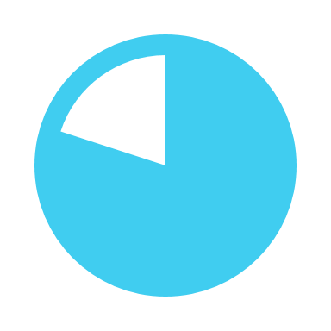
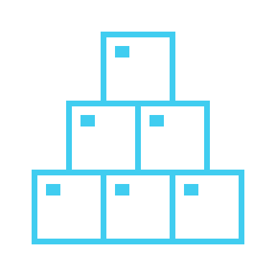
Characteristics of forecasts
1. Forecasts are (almost) always wrong
2. All Products are Not equally forecastable
No one has a crystal ball. The objective is to minimize error in the forecast.
Error Tolerance depends upon:
1) Adjustment Capability
2) Cost of an Error.
New, highly promoted, shorter life cycle, and intermittent (sporadic or lumpy) demand products are generally more difficult to forecast.
Accuracy generally increases for group of products rather than for an individual product.

Slide 10


Characteristics of forecasts
3. Each function has its own bias
4. Near-term forecasts are more accurate than Long-term
e.g., Functions tend to over-forecast if they are evaluated based on product availability however might under-forecast if they are evaluated based on achieving revenue targets.
Demand forecasts must be assessed not only on how accurate they are, but also on how biased (+/-) they are.
Farther the demand forecast is extended into the future, higher the forecast inaccuracy.
Forecast horizon depends on the lead time (time to produce a product).
Forecasts are more useful if prepared early enough to react.

Slide 11
Quiz
Capacity Planning is an example of __________ forecasting and planning.
A. Operational short-term
B. Strategic long-term
C. Macroeconomic
D. None of the Above

Slide 12
Bonus Quiz
Long-term forecasts are more accurate than Near-term forecasts. True or False?
A. True
B. False
C. Lead-time
D. None of the above

Slide 13

Forecasting: A Rocket Science?
SCIENCE through Data Modeling
-mathematical models to create forecast from historical data.
ART through Business Consensus
-agreeing on one number forecast.

